Slide 1

ILLINOIS INSTITUTE OF TECHNOLOGY
Laboratory Safety – Safe Chemical Storage Practice

Slide 2
CHEMICAL STORAGE
General Considerations:
Plan ahead for spills, accidents or emergencies
Be Aware of special Storage Conditions
Temperature.
Relative humidity.
Limited shelf life
Segregate chemicals by hazard class or compatibility

Slide 3
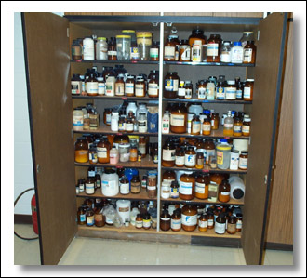
CHEMICAL STORAGE
SAFE CHEMICAL STORAGE PRACTICE IS CRITICAL:
Chemical Inventories MUST Be Kept Up To Date.
Quantities in Use and “In-Use Dates” Are Critical.
Ensure the Chemical Hygiene Plan Is Current.
Proper Labeling Is Absolutely Essential.
All Labels Must Face To The Front.
Training in Storage Procedures Is Critical.
Regular Facility Inspections Are Essential.
Keep Current On Best Storage Technologies.
Test Emergency Systems Regularly.

Slide 4
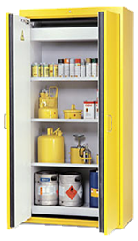
CHEMICAL STORAGE
General Considerations:
Use ventilated cabinets for volatile toxics and odoriferous chemicals.
Use approved flammable storage cabinets for flammable liquids.
Use secondary containers or trays for corrosives and toxic solvents

Slide 5
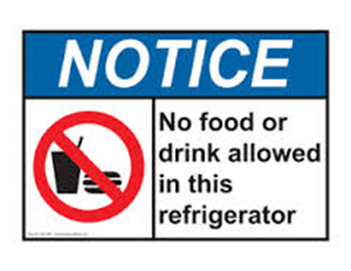
CHEMICAL STORAGE
(Continued)
General Considerations:
When refrigerating flammables, ONLY use refrigerators specifically designed for flammable materials.
DO NOT store food or drink in chemical storage refrigerators.
Label Chemical storage refrigerators with the following: Notice: No food or drink allowed in this refrigerator
Refrigerators/freezers/coolers not UL-rated for flammables storage will also need a black and white sticker with the wording “Do not store flammable solvents in this refrigerator”.

Slide 6
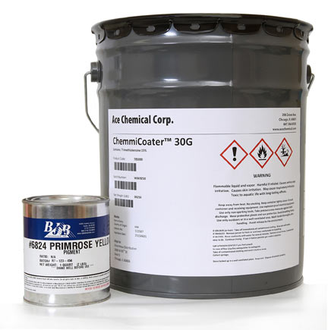
CHEMICAL STORAGE
(Continued)
SAFE CHEMICAL STORAGE PRACTICE IS CRITICAL:
Ensure Each Container Is Identifiable:
Is It Labeled and Dated?
Are Containers Positioned So the Label Is Visible?
Are “Oldest” Items Rotated (used) First?
Determine What You Really Use and Need:
Can You Order a Smaller Per Unit Quantity?
Can You Order a Safer Substitute Material?
Can the Facility Safely Handle On-Hand Quantities?

Slide 7
CHEMICAL STORAGE
(Continued)
SAFE CHEMICAL STORAGE PRACTICE IS CRITICAL:
Avoid storing any chemical above eye level. Due to limited space in laboratories, any chemicals stored above eye level:
Must not be a liquid.
Must not be a gas, such as a lecture bottle.
Must not be in a glass or other brittle container.
Must not be a hazardous chemical.
Must not be in a container that is heavy.
Must be in a container that is easy to manipulate.
Must be in a sealed container.

Slide 8
CHEMICAL STORAGE
(Continued)
General Considerations:
Avoid storing chemicals in aisle ways.
Avoid over stocking shelves
Avoid storing heavy containers above shoulder level
Avoid storing chemicals in fume hoods or on counter tops.
Avoid storing chemicals near sources of heat or in direct sunlight.
Avoid storing anything on the floor, especially glass bottles.
Do not store incompatible chemicals together.

Slide 9
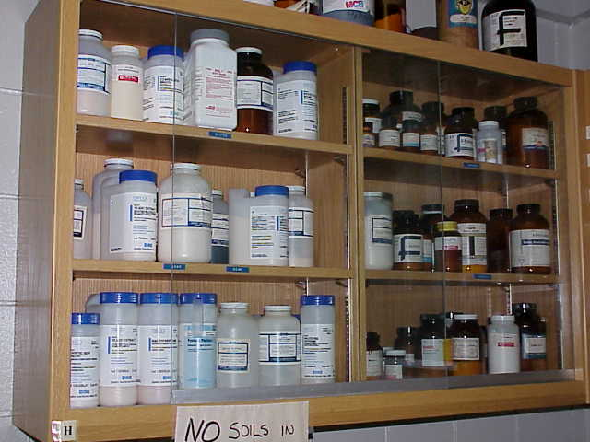
CHEMICAL STORAGE AND SAFETY
CHEMICAL STORAGE AND SAFETY - GENERAL:
Dry Chemicals Must be Stored By Groups.
ALWAYS FOLLOW LOCAL PROCEDURES

Slide 10
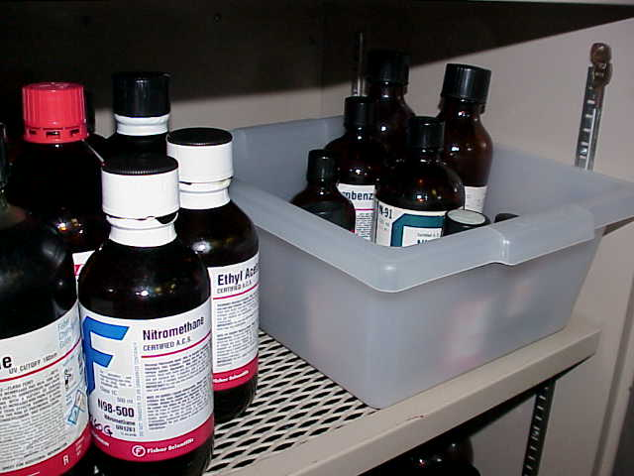
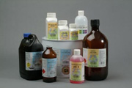
CHEMICAL STORAGE AND SAFETY
(Continued)
CHEMICAL STORAGE AND SAFETY - LIQUID CHEMICALS:
Liquid Chemicals Should Be Stored By Class. Examples Of Such Groupings Include Flammables, Organic Acids, Mineral Acids, Bases, Oxidizers And Carcinogens.
Where Storage Space Is Limited, Separation Using Plastic Tubs Is Acceptable When Authorized.
ALWAYS FOLLOW LOCAL PROCEDURES

Slide 11





Chemical Storage – Hazard Class
At a minimum, chemicals should be segregated as:
Corrosives
Oxidizers
Flammable Liquids
Poisons or Toxic Chemicals
Reactive (water or time sensitive)

Slide 12
CHEMICAL STORAGE
(Continued)
SAFE CHEMICAL STORAGE PRACTICE IS CRITICAL:
Acids Are Incompatible With:
Bases and Alkalines.
Flammable Solvents.
Oxidizers.
Use secondary containers for Acids and Bases.
Do not store acids on metal shelves.
Cyanides Should Be Stored Separately From Acids.

Slide 13
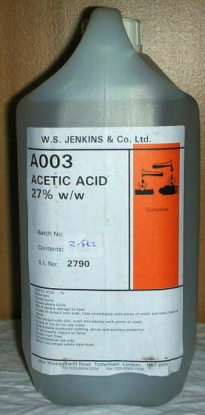
CHEMICAL STORAGE
(Continued)
Corrosives Continued:
Acetic acid has a low combustion temperature.
It should not be stored near strong oxidizers like sodium peroxide, nitric acid and chromic acid.
It should not be stored near strong acids.
It should not be stored near strong bases like chlorine bleach.
Good ventilation is very important when working with this chemical.
It should be stored in a fireproof area.
It should be stored in its original, well closed container.

Slide 14
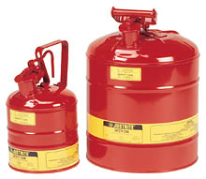
CHEMICAL STORAGE
(Continued)
Flammable Liquids:
No more than 10 gallons of flammable liquids should be stored outside of an approved flammable storage cabinet.
No more than 50 gallons combined (outside and inside of cabinet) of flammable liquid will be stored in a laboratory.

Slide 15

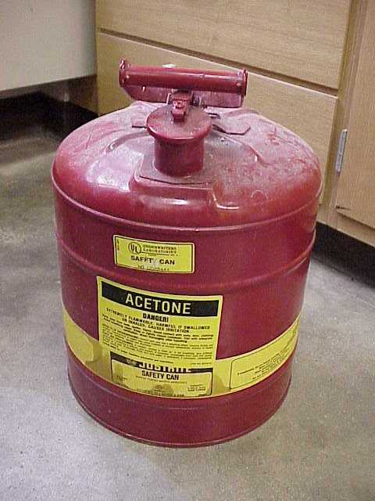
CHEMICAL STORAGE AND SAFETY
(Continued)
CHEMICAL STORAGE AND SAFETY - FLAMMABLES:
Flammable Liquid Quantities Of More Than One Gallon Must Be Stored In Flammable Liquid Containers.
ALWAYS FOLLOW LOCAL PROCEDURES

Slide 16
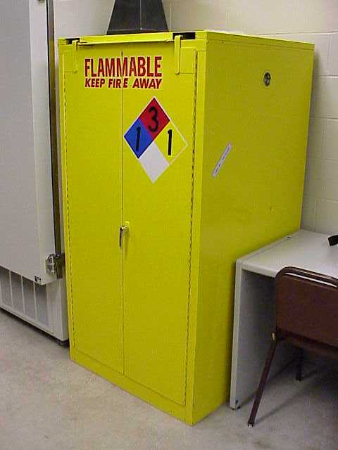

CHEMICAL STORAGE AND SAFETY
(Continued)
CHEMICAL STORAGE AND SAFETY - FLAMMABLES:
If Aggregate (Total) Flammable Liquid Quantities Exceed 10 Gallons, These Materials Must Be Stored In A Flammables Storage Cabinet.
ALWAYS FOLLOW LOCAL PROCEDURES

Slide 17
CHEMICAL STORAGE
(Continued)
Toxic Chemicals:
Store Highly toxic Materials in a dedicated storage fume hood.
Maintain the minimum quantity needed and dispose of unneeded material immediately.
Store in unbreakable containers and use secondary containers.
Label storage areas with designated area signs

Slide 18
CHEMICAL STORAGE
(Continued)
Oxidizers:
Store oxidizers away from flammable and combustible materials
Store oxidizers away from reducing agents.
Maintain the minimum quantity needed and dispose of unneeded material immediately

Slide 19
CHEMICAL STORAGE
(Continued)
Reactive:
Examples of reactive chemicals would include, but are not limited to:
Water reactive chemicals.
Pyrophors, which react with air.
Peroxide forming chemicals, which form shock sensitive explosions

Slide 20
CHEMICAL STORAGE
(Continued)
Reactive:
Date all reactive chemicals as soon as they are received
Consult the SDS and labels for storage information.
Bring only quantities needed for immediate use into the laboratory.
Do not open material after the expiration date.

Slide 21
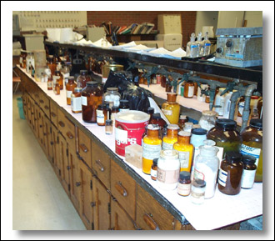
CHEMICAL STORAGE
(Continued)
SAFE CHEMICAL STORAGE PRACTICE IS CRITICAL:
Water Reactives Should Be Stored Separately.
Low Flashpoint Flammable Materials Should Be:
Inventoried Regularly.
Stored in an Explosion Proof Refrigerator.
Monitored Daily.
Tightly Controlled.

Slide 22
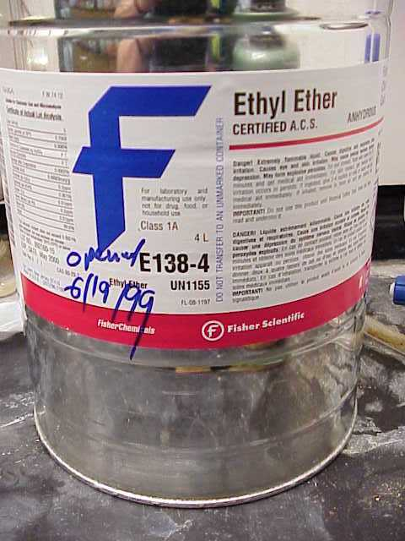
CHEMICAL STORAGE AND SAFETY
(Continued)
CHEMICAL STORAGE AND SAFETY - PEROXIDES:
Peroxide Formers Must Be Marked With Date Of Receipt And Date Of Opening.
The Chemical Hygiene Plan Will Contain Detailed Information For Peroxide-former Storage.
Peroxide Test Kits And Strips Are Available From Most Chemical Supply Houses.
Peroxide Formers must be inventoried regularly
Peroxide Formers must be disposed of per NFPA AND Lab requirements
Store peroxidizable materials away from heat and light.
ALWAYS FOLLOW LOCAL PROCEDURES

Slide 23
CHEMICAL STORAGE
(Continued)
Reactive:
Store pyrophoric chemicals away from flammables.
Store perchloric acid away from reducing agents.
Store perchloric acid bottles in glass or ceramic trays.

Slide 24
CHEMICAL STORAGE
(Continued)
Reactive:
Store water reactive chemicals away from all sources of water and in water tight containers.
Store thermally unstable chemicals in approved refrigerators.
Consider explosion relief boxes for highly sensitive materials.
Restrict access to the storage area.

Slide 25
CHEMICAL STORAGE
(Continued)
Reactive:
Picric Acid must be tightly controlled.
Can Be as Explosive as TNT.
Totally Unstable When Water Evaporates Off.
Fire Fighters Worst Nightmare.
Understand Picric Acid MSDS/SDS - Read, Read,& Read.
Restrict access to the storage area.

Slide 26
CHEMICAL STORAGE
(Continued)
Chemical Storage
For further information or assistance, contact the Department of Environmental Health and Safety at
(312) 567-3084

